Slide 1
Database Corruption
By Stephen Muliokela

Slide 2

About me
Name; Stephen A Muliokela
Work; Imagine Software –DBA

Slide 3
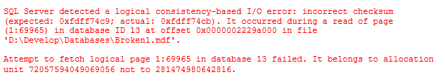
Database Corruption. Now What?
What to do when the database is corrupt.
Don’t panic.
Don’t detach the database.
Don’t restart SQL Server.
Don’t just run repair.
Run an integrity check.
Afterwards do a root cause analysis.

Slide 4
Why Database corruption occurs
Almost always the I/O subsystem
I/O subsystem means anything underneath SQL Server
Windows operating system
File system filter driver
E.g. antivirus, defrager, encryption
Network cards, switches, cables
SAN controllers, RAID controllers
Disk
Other;
High temperature, vibrations, power cycling not ideal
Could be version related/SQL Server bugs(Service pack missing)
Memory corruption; bad memory chips(data held will be corrupt).
Human Error
Manually edit the database e.g. sys tables.
Manually deleting the transaction log.

Slide 5
Possible Repair options
Restore from a clean backup.
Restore corrupted page from a valid backup.
Export data to different table/(s) or database.
Use DBCC Repair options/ variation of repair.
Run Chkdsk to repair any disk problems.
Contact your hardware vendor(write caching should not be enabled)
Reformat the disk drives.
Reinstall operating system (gets rid of any corrupted .dll or .exe program).

Slide 6
Corruption propagation
SQL Server redundancy technology do not propagate corruption to secondary servers.
Database mirroring, log shipping, replication, availability group.
Send log records not pages.
Hidden corruption; propagated because of bad calculation due to corruption.
SAN replications should not propagate corruption.

Slide 7
Preparing for database corruption
Know your SLAs
Recovery Point Objective(RPO)
Recovery Time Objective(RTO)
Design a recovery strategy to them
Test your Recovery strategy.
The SLA gives way to Recovery Plan
How often should you take backups
How big is your database?
How long is the maintenance window?
Type of backups included and schedule too meet the need
Full backups, differential backups, Log backups,
filegroup backups
Recovery model
How long will you keep the backups for?
Backup option; with checksum , test verify them.

Slide 8
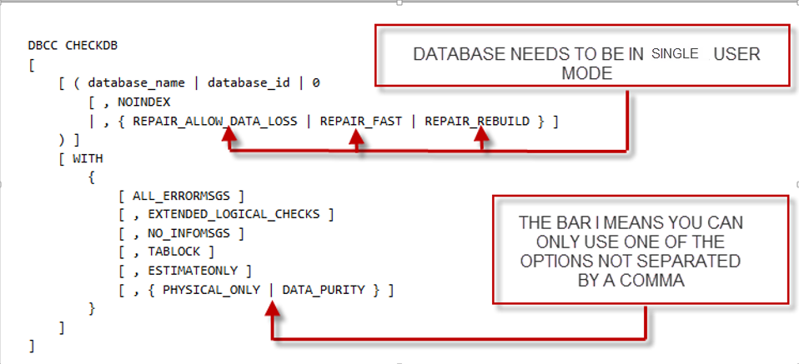
DBCC CHECKDB SYNTAX

Slide 9
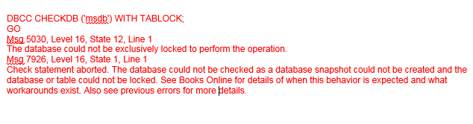
DBCC CHECKDB() Special considerations
DBCC CHECKDB does not examine disabled indexes.
In versions before SQL Server 2005 SP 2, DBCC cleared the plan cache which would cause recompilations and cause the system to be slow.
DBCC CHECKDB obtains database level exclusive lock to prevent changes. (non snapshot )
DBCC waits for 20 seconds or the configured timeout value for a database lock to be released then gives off this error-TABLOCK option (non snapshot )
Exclusive locks are dropped when allocation units checks are completed at the database level-

Slide 10
DBCC CHECKDB() Special considerations
DBCC CHECKDB operates on an internal read only database (database snapshot);to prevent blocking and concurrency issues.
If the snapshot cannot be created, DBCC runs WITH TABLOCK option.
An internal database snapshot cannot be created with DBCC in the following cases;
Against the database or instance of SQL Server is running in single-user mode
Against a ready-only database.
Against a database that is placed in EMERGENCY mode
Against tempdb.
WITH TABLOCK option is explicitly specified.
Database is created on a non-NTFS file system(snapshot creation depends on NTFS sparse – file technology)
DBCC commands defaults to a table lock instead of a database snapshot when run it against a read only FILEGROUP.

Slide 11
DBCC CHECKDB() Special considerations
DBCC CHECKDB will run in parallel on Enterprise edition
You can limit parallelism using;
the trace flag 2528( increases run time but reduces resources used).
up to limit imposed by sp_configure MAXDOP or
Resource governor workload group MAX_DOP setting
Ported for 2008, 2008 R2, 2012 trace flags to improve DBCC processing
Ported with the latest service packs.
Trace flag 2562; runs DBCC CHECKDB in single batch
minimizes impact on tempdb and contention on
DBCC_MULTIOBJECT_SCANNER latch.
May want to grow tempdb by 5%.
Indexes on computed columns slow down DBCC CHECKDB - bottleneck occurs on the DBCC_OBJECT_METADATA latch.

Slide 12
Running a Repair
DBCC check DB will tell you which repair option will resolve the issue.
You can put a transaction around your repair operation and roll it back if you like what the repair suggestion.
REPAIR_ALLOW_DATA_LOSS doesn’t account for
Foreign-Key constraints
Inherent business logic and data relations
Replication

Slide 13
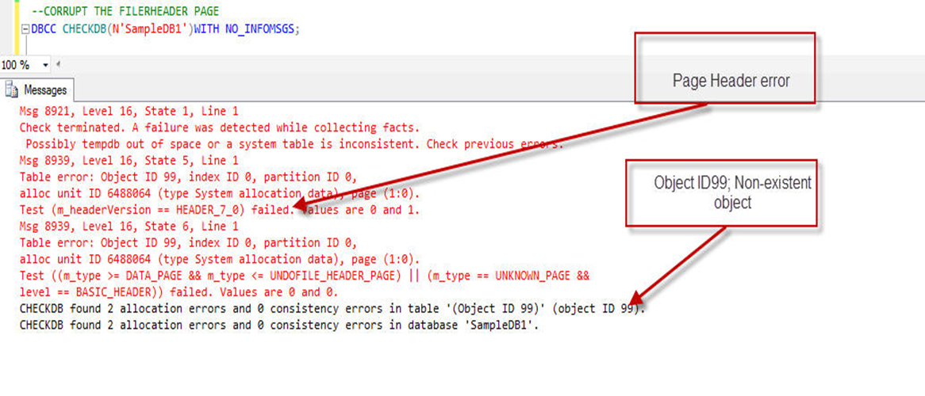
Database corruption; Fatal Error
Not all errors can be fixed using Repair_Allow_Data_Loss option repair option;
Indications of fatal error
You have experienced an Objectid 99 (Non existent object)
If the boot page is corruption page(1:9).
Other errors e.g. 7985 or check terminated error
When you have file header errors
PFS page, Corrupt metadata, Critical system table corruption 2540, 7991
No minimum repair option is given by DBCC

Slide 14
Automatic Page Repair; database corruption
Automatic page repair is supported by
Database Mirroring and AlwaysOn Avaliability Group
Applies to errors 823,824 and 829
Page types that cannot be repaired
Page 9
File header page
Allocation pages ; GAM, SGAM and PFS pages
View Automatic Page-Repair Attempts
AlwaysOn Availability Group;
sys.dm_hadr_auto_page_repair
Database Mirroring
sys.dm_mirroring_auto_page_repair

Slide 15
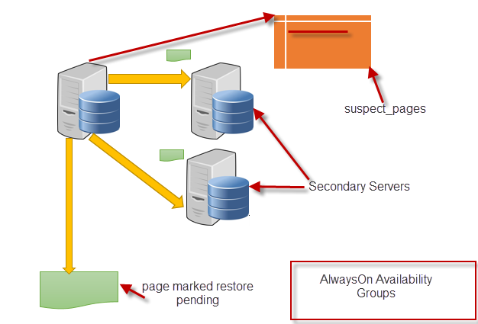
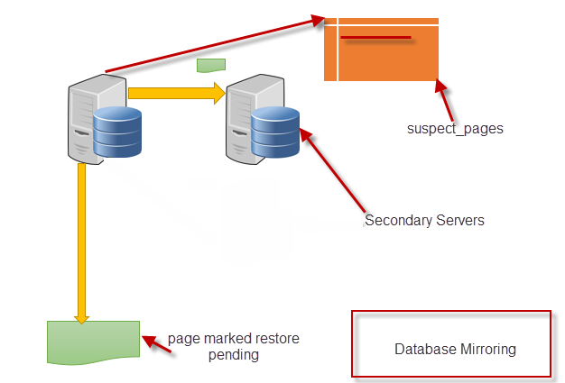

Automatic Page Repair; database corruption

Slide 16
DBCC CHECKDB() Special considerations
DBCC CHECKDB operates on internal read only database (database snapshot)that is created to prevent blocking and concurrency issues.
If the snapshot cannot be created, DBCC uses table locking same behavior as using WITH TABLOCK.
An internal database snapshot cannot be created when the DBCC command is executed in the following cases;
Against the database or instance of SQL Server is running in single-user mode
Against a ready-only database.
Against a database that is placed in EMERGENCY mode
Against tempdb.
WITH TABLOCK option is explicitly specified.
Database is created on a non-NTFS file system(snapshot creation depends on NTFS sparse –file technology)
DBCC commands defaults to a table lock instead of a database snapshot when run it against a read only FILEGROUP.

Slide 17
Resolving Database Corruption using SQL Server Service packs.
Data corruption occurs in clustered index when you run an online index rebuild when concurrent queries are running against the same data.
Versions affected; SQL Server 2012 and SQL Server 2014
Latest service pack for SQL Server 2012 and SQL Server 2014 fixes this issue.

Slide 18
Undocumented DBCC commands
DBCC IND
DBCC PAGE
DBCC DBINFO
DBCC DBTABLE
DBCC WRITEPAGE

Slide 19
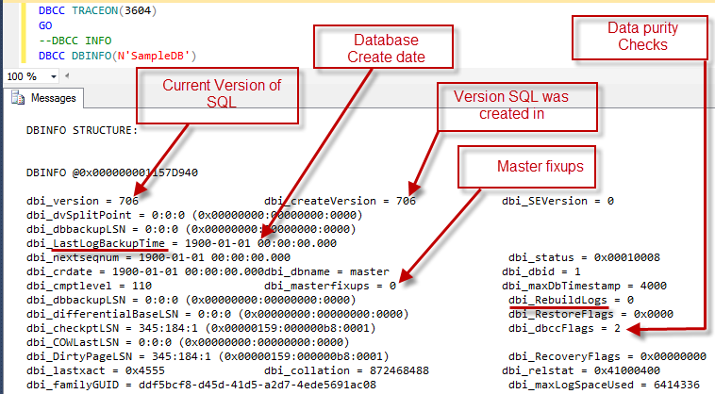
DEMO; DBCC DBINFO

Slide 20
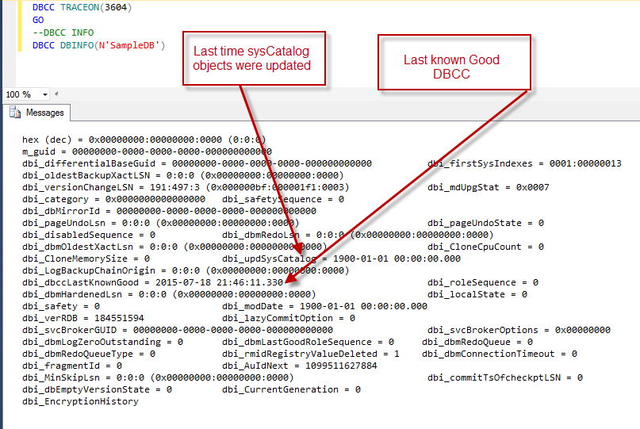
DEMO; DBCC DBINFO continued

Slide 21
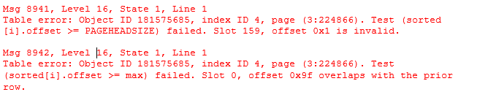
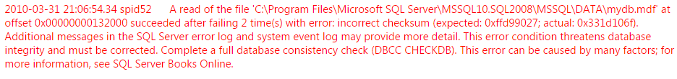
Examples of database corruption
Corruption only in the nonclustered indexes
Disable the associated object nonclustered indexes
Drop the disabled indexes
Recreate the disabled indexes
Other errors pointing to index corruption; 8915,8955,8952,8956
2. Error 825 Read retry(Msg 823 or 824)
Read re-try up to four times before failing read/write
No action needed- Caution check I/O subsystem.

Slide 22


Examples of database corruption continued
3. Memory corruption(error 832)
SQL Server 2012 on windows 2012
Re-reads corrupted page into memory from disk
Cannot repair dirty page-Different from page in memory
4. Data Purity Errors(Error 2570)
e.g. out of range data exists in column

Slide 23
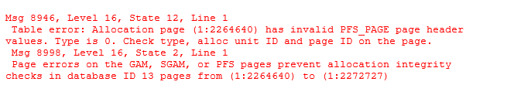
Examples of database corruption continued
5. Error 605
Damaged page chain,
corrupt Index Allocation MAP(IAM)
Invalid entry in sys.objects for the object
605 could be transient
6. Deleted transaction log

Slide 24
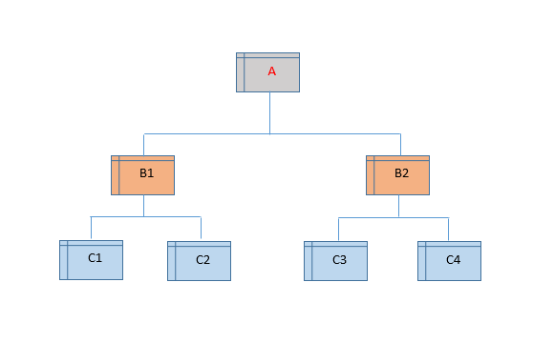
Examples of database corruption continued
7. B-Tree Errors
Error 8931; Level mismatch
Error 8934; Last Key in C1!<lowest Key in C2
Error 8935; B2 thinks C4 is C3’s left sibling
Error 8937; B1 and B2 both point to page C2

Slide 25
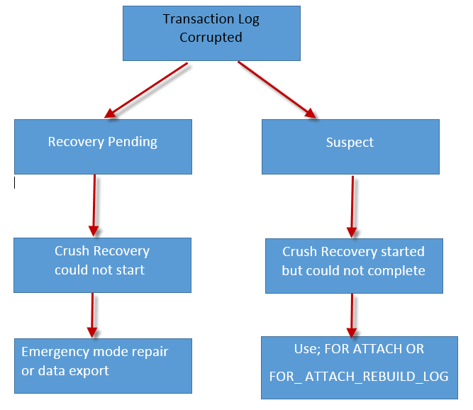
Transaction Log corruption

Slide 26
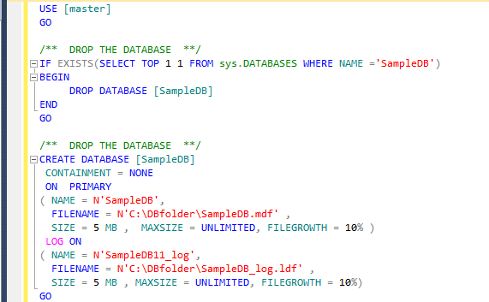
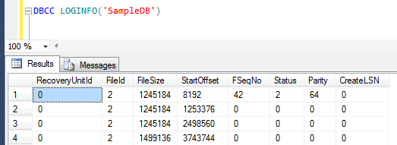
DEMO; Transaction Log corruption; with clean shutdown
Create the database; with one log file
Check the number of virtual Log Files

Slide 27
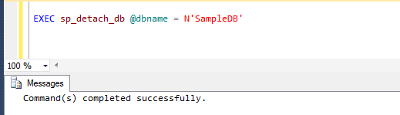
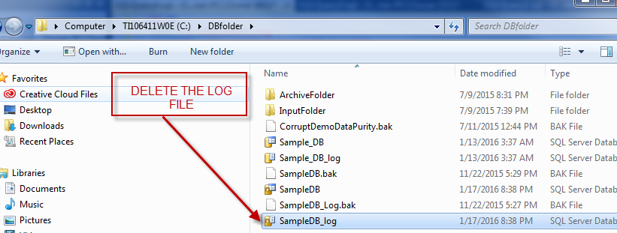
DEMO; Transaction Log corruption with clean shutdown continued
Detach the created database
Delete the log file

Slide 28
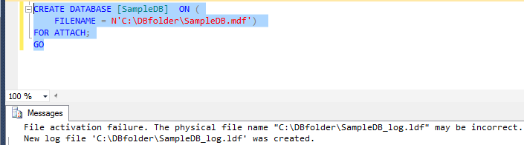
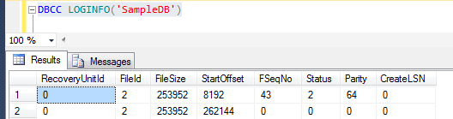
DEMO; Transaction Log corruption
Reattach the database using the FOR ATTACH option
Check the virtual Log files

Slide 29
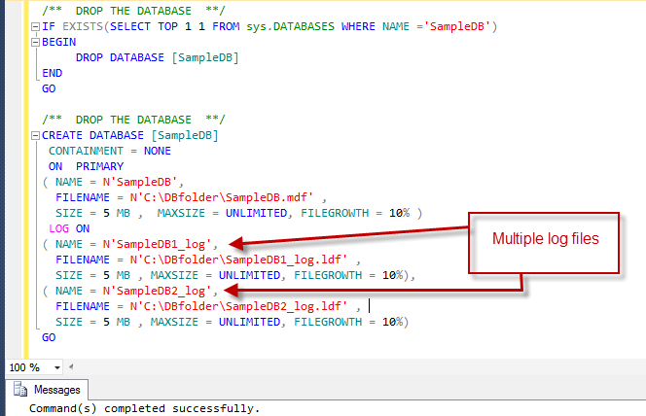
DEMO; Transaction Log corruption
Create database with multiple log files

Slide 30
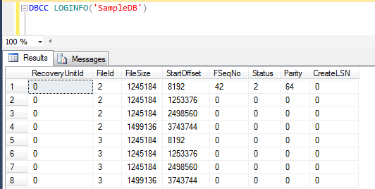
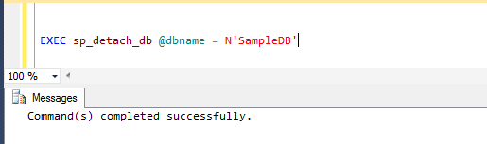
DEMO; Transaction Log corruption
Check the number of log files for the newly created database
Detach the database

Slide 31
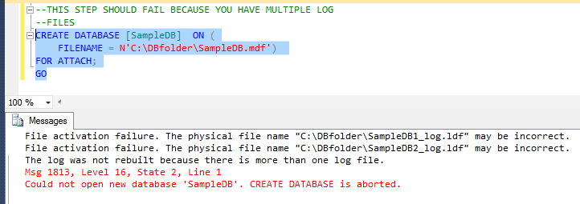
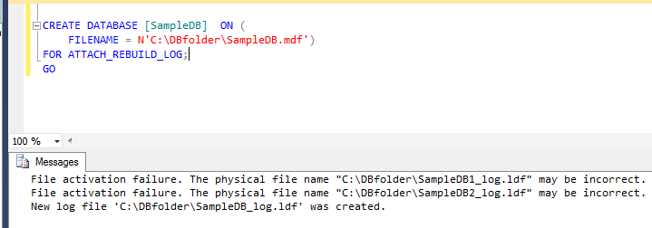
DEMO; Transaction Log corruption
Try to re-attach the database using the FOR ATTACH option
Re attach the database using the FOR ATTACH_REBUILD_LOG

Slide 32
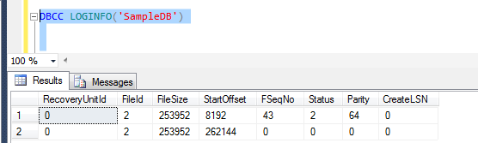
DEMO; Transaction Log corruption
Check the number of virtual log files created

Slide 33
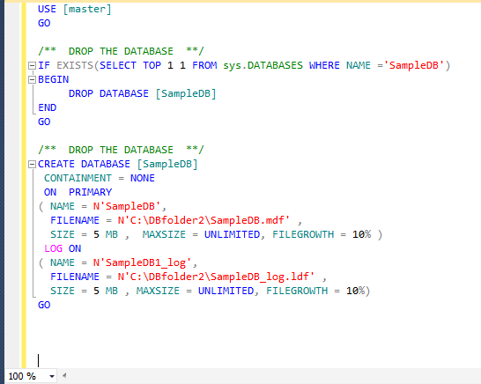
DEMO; Transaction Log corruption without a clean shutdown
Create the database

Slide 34
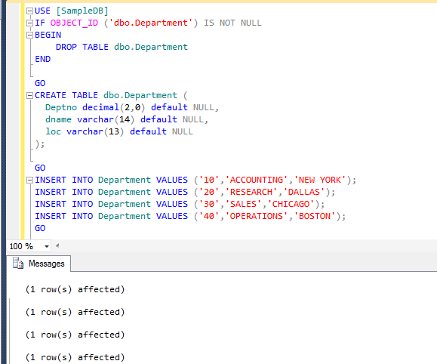
DEMO; Transaction Log corruption without a clean shutdown
Create the Department table and insert records into the table

Slide 35
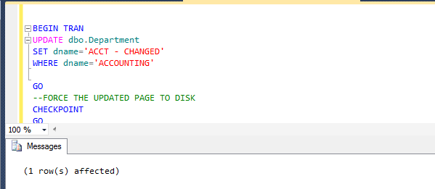
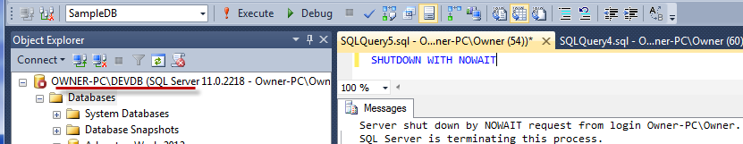
DEMO; Transaction Log corruption
Begin a transaction and update record. Force the updated page to be pushed to disk
In a separate window issue a shutdown

Slide 36
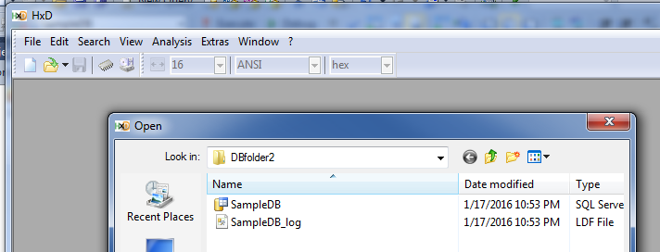
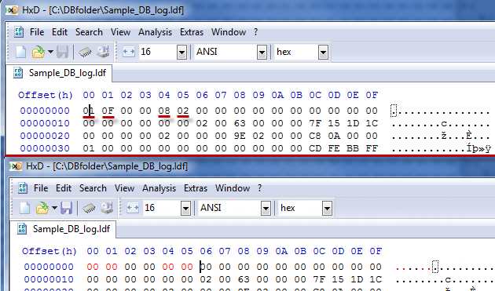
DEMO; Transaction Log corruption
Open up a Hex editor, open up the Log file in the Hex editor

Slide 37
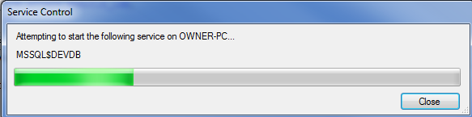
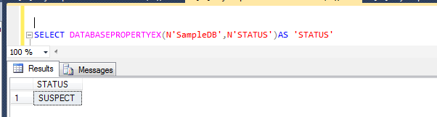
DEMO; Transaction Log corruption
Restart SQL Server after corrupting the log
Check the status of the database who log is now corruption; SUSPECT

Slide 38
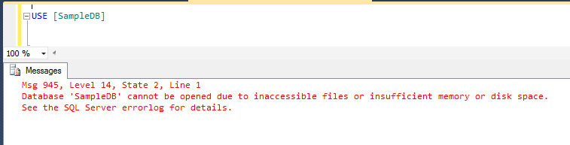
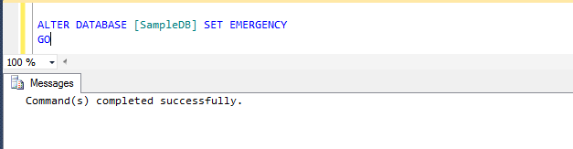
DEMO; Transaction Log corruption
Try to get into the database
Take the database into EMERGENCY mode

Slide 39
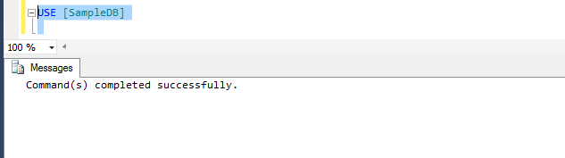
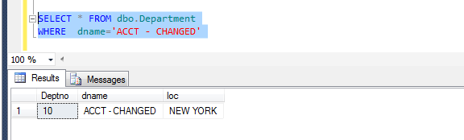
DEMO; Transaction Log corruption
Try to get into the database; SUCCESS
Check if transaction was rollback – Emergency mode(database still corrupted)

Slide 40
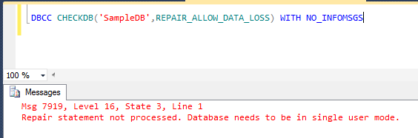
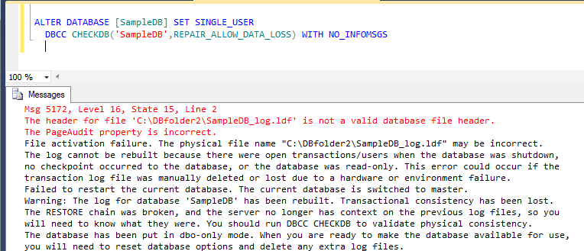
DEMO; Transaction Log corruption
Try to run repair in EMEGENCY mode
Check if transaction was rollback – Emergency mode(database still corrupted)

Slide 41
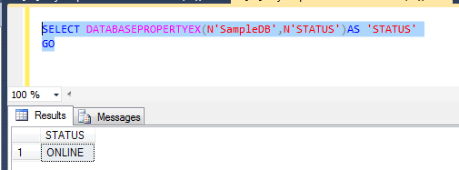
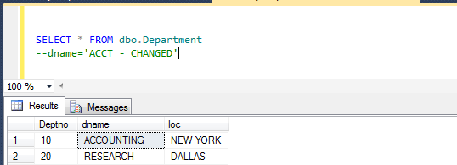
DEMO; Transaction Log corruption
After the fix the database is brought back ONLINE
Transaction that was not committed is rolled back; We lose the changes.

Slide 42
DEMO; Transaction Log corruption; Unrepairable Error
Create the database

Slide 43
DEMO; Transaction Log corruption; Unrepairable Error
Create the Department table and insert records into the table

Slide 44
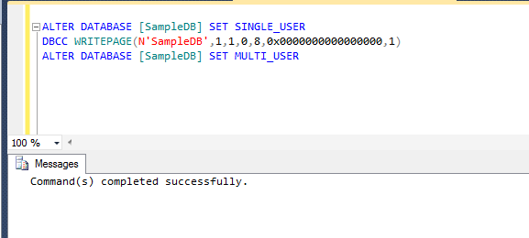
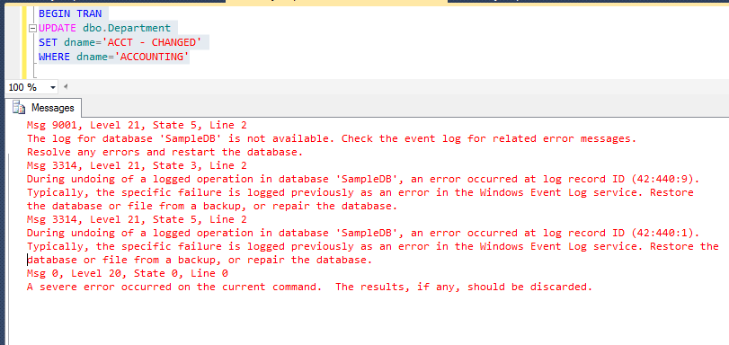
DEMO; Transaction Log corruption; Unrepairable Error
We corrupt the PFS page
Check if transaction was rollback – Emergency mode(database still corrupted)

Slide 45
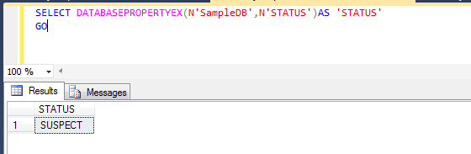
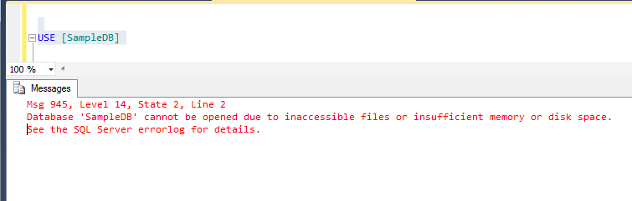
DEMO; Transaction Log corruption; Unrepairable Error
Check the status of the database
Try to get into the database

Slide 46
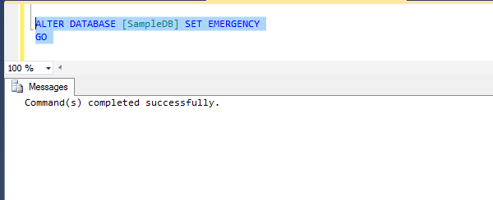
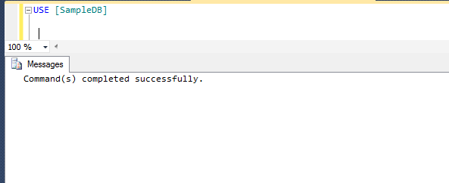
DEMO; Transaction Log corruption; Unrepairable Error
Change the database to Emergency
Try to get into the database

Slide 47
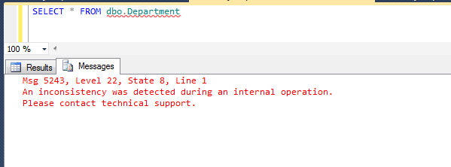
DEMO; Transaction Log corruption; Unrepairable Error
Change the database to Emergency

Slide 48
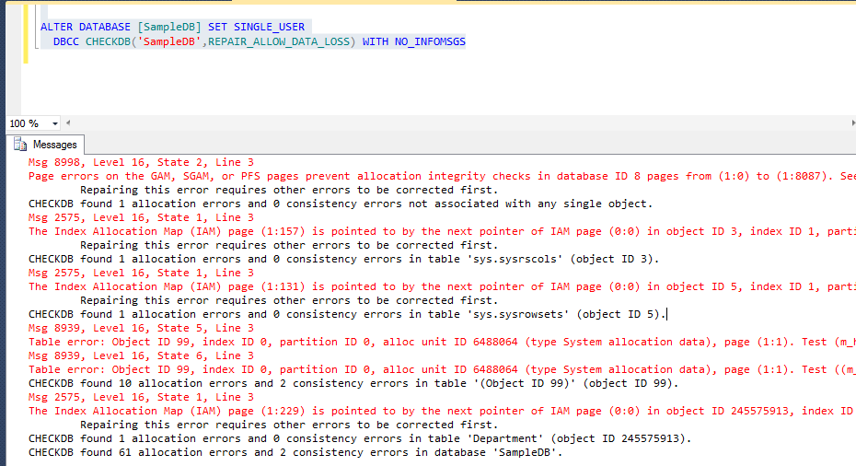
DEMO; Transaction Log corruption; Unrepairable Error
Run a DBCC repair ; Error is not fixed

Slide 49
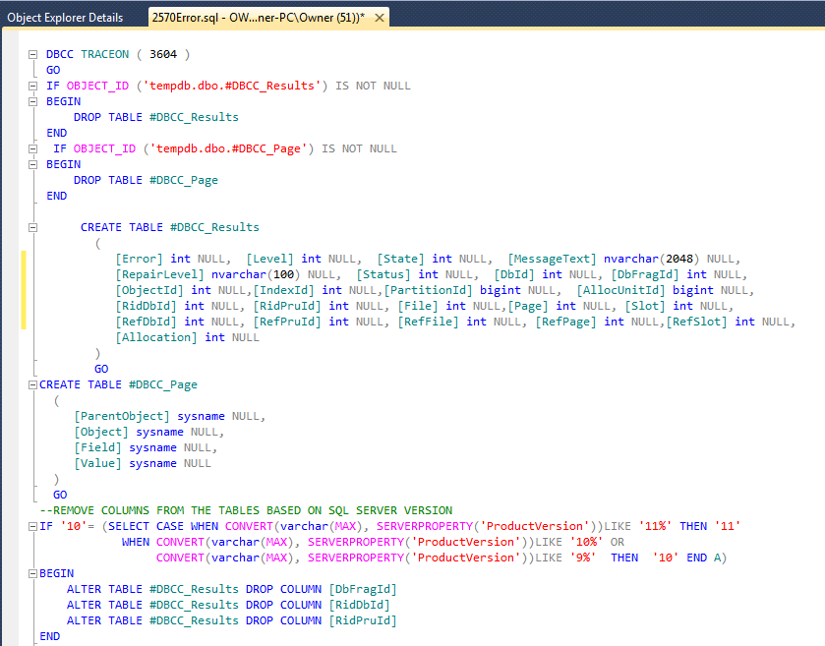
My custom solution to Error 2570

Slide 50

Continued

Slide 51
Monitoring for I/O Error
Manual monitoring time consuming
Automated monitoring
SQL Agent alerts –severity 19 and above
Third party monitoring tools

Slide 52
Verify Backups
Requires WITH CHECKSUM option when performing backups.
Verifies pages as they are read with checksum calculation-verify that every page is setup correctly(During the backup process).
Checks integrity of backups -Impact if negligible
Allows you to check the integrity of backups using Restore verify only.

Slide 53


Verify Backups: Example
Test 1; Backup database without Checksum option

Slide 54

Verify Backups: Example
Test 2; Backup database with the Checksum option

Slide 55


Verify Backups: Example
Test 3; Backup database with Checksum option
With Error(Force Backup to succeed)

Slide 56


Verify Backups: Example
Test 4; Backup database with trace flag 3023 (same as using Checksum) (Force Bkp success)

Slide 57
Restoring from Backups
System databases
Use backup from the same service pack level as SQL Server instance
E.g. RTM backup of master will not restore on SP1
Restore model and msdb same as user databases.
Version restore Enterprise; version of backup containing enterprise only features cant be restored to other features
Can be a setback
Use DMV sys.dm_db_persisted_sku feature to whether any of your databases are enterprise –only.

Slide 58

Q ?- Email muliokelastephen@yahoo.com

